Slide 1
Lecture 09 Large Sample Theory of MLE
Dr. Shafayat Abrar

Slide 2
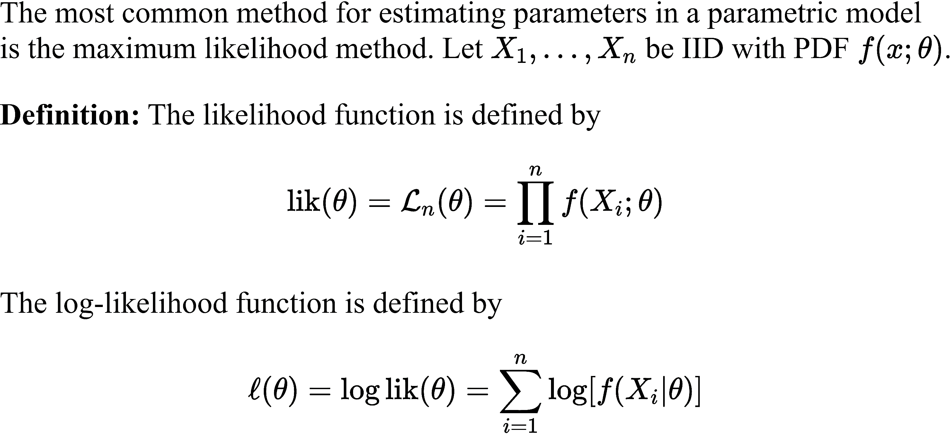
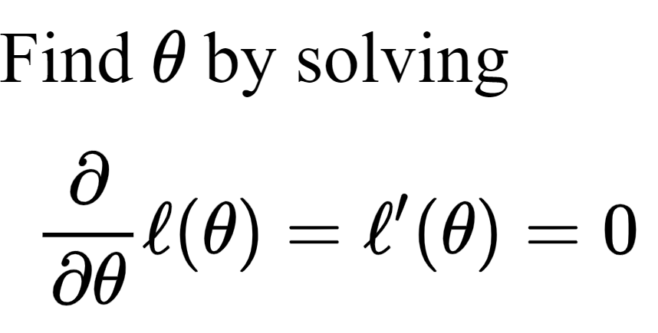
The Method of Maximum Likelihood
for Point Estimation

Slide 3
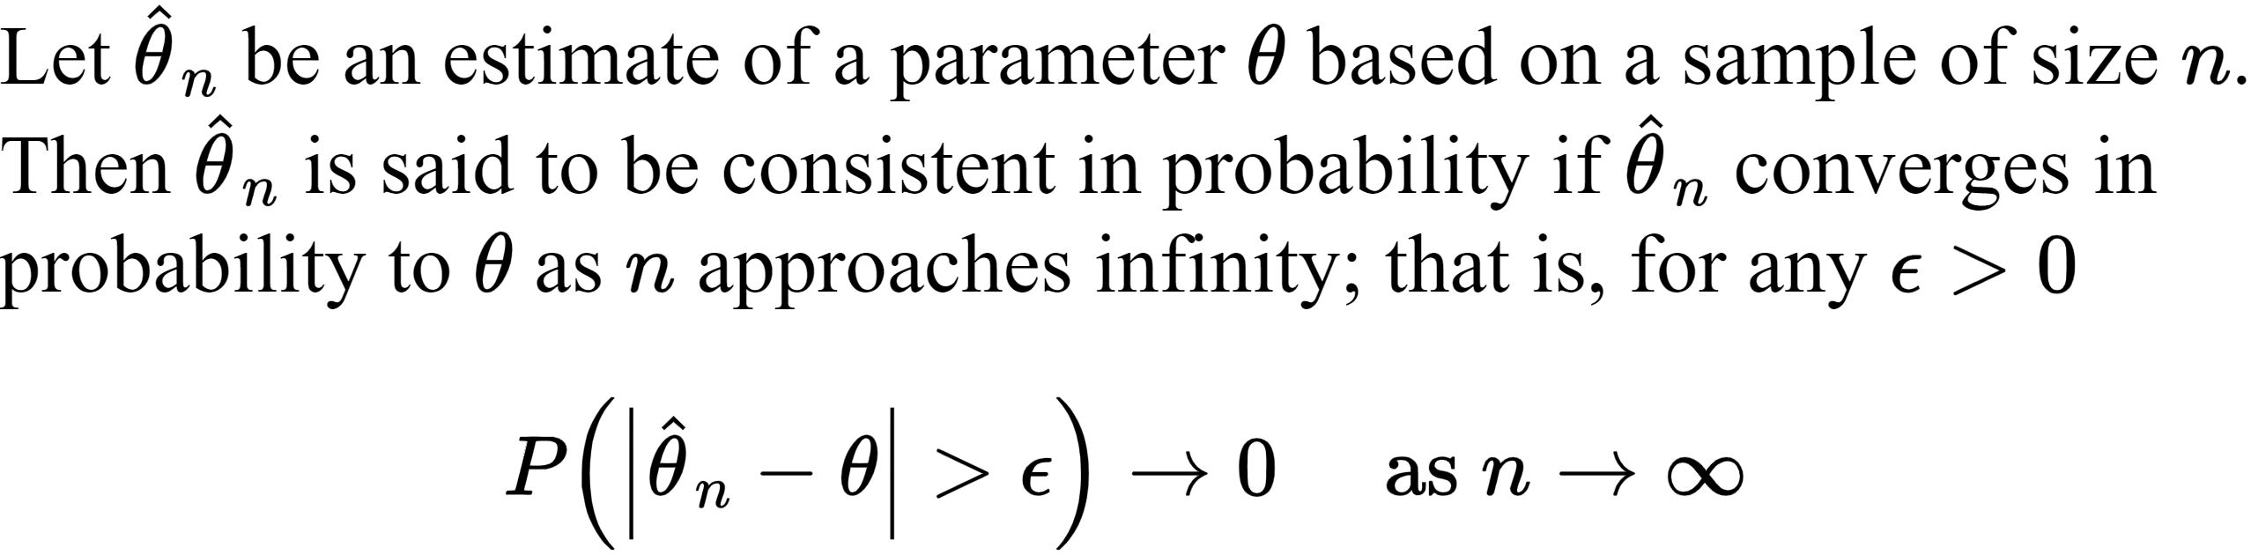
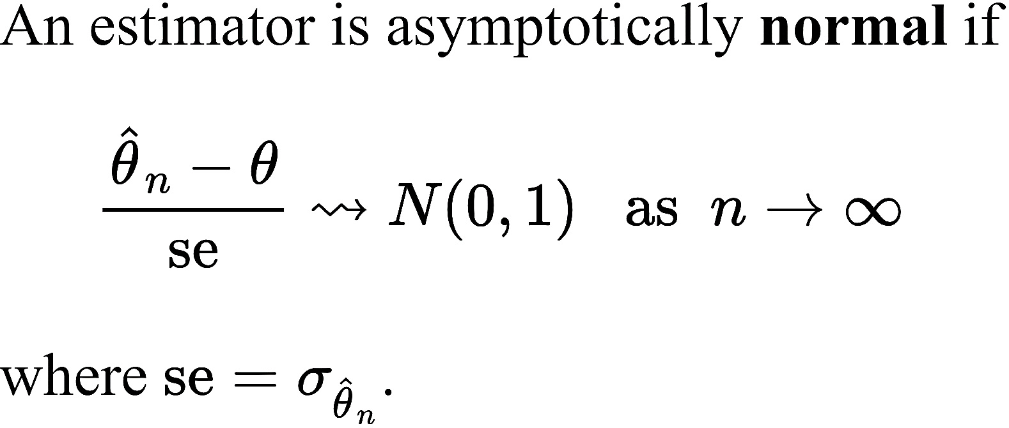
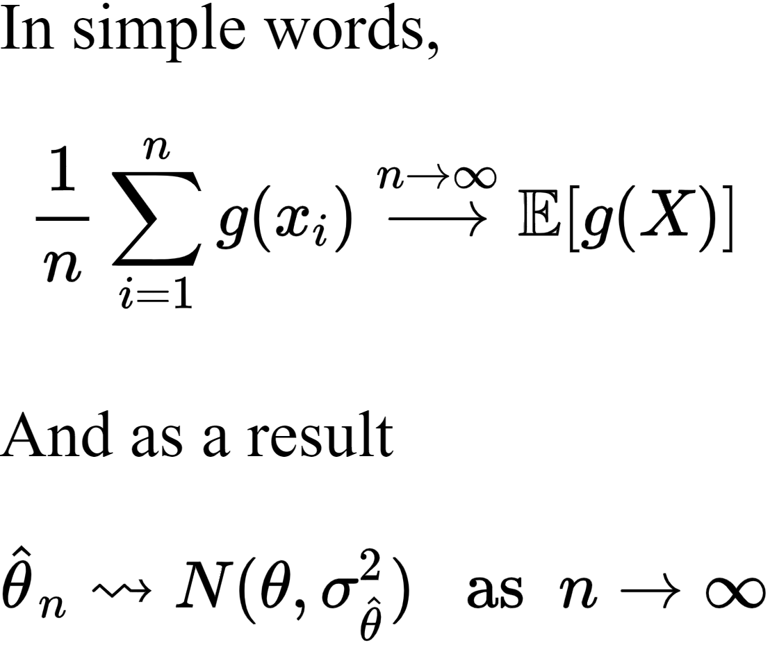
Large Sample Theory

Slide 4
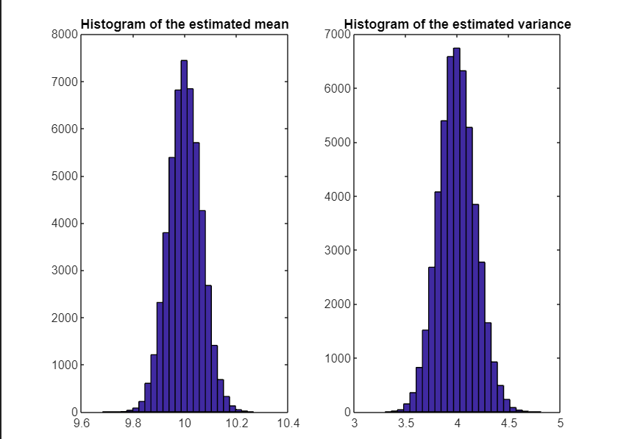
clear
n=1000;
mu_true = 10;
sigmga_square_true = 4;
for jj=1:50000
X=randn(1,n)*sqrt(sigmga_square_true)+mu_true;
mu_ML(jj) = mean(X);
var_ML(jj)= mean((X-mu_ML(jj)).^2);
end
subplot 121
hist(mu_ML,25)
title('Histogram of the estimated mean')
subplot 122
hist(var_ML,25)
title('Histogram of the estimated variance')

Slide 5
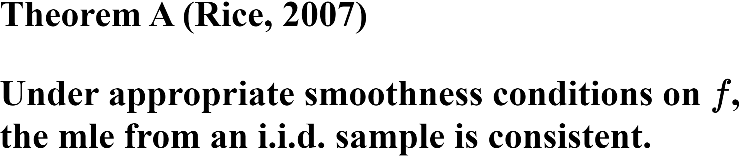
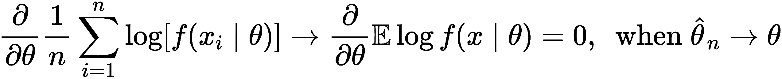
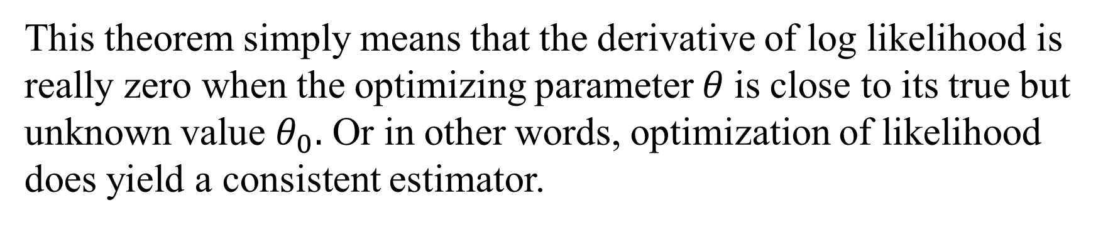
Large Sample Theory for Method of Maximum Likelihood
This theorem simply means that the derivative of log likelihood is really zero when the optimizing parameter $θ$is close to its true but unknown value $θ_{0}.$ Or in other words, optimization of likelihood does yield a consistent estimator.

Slide 6
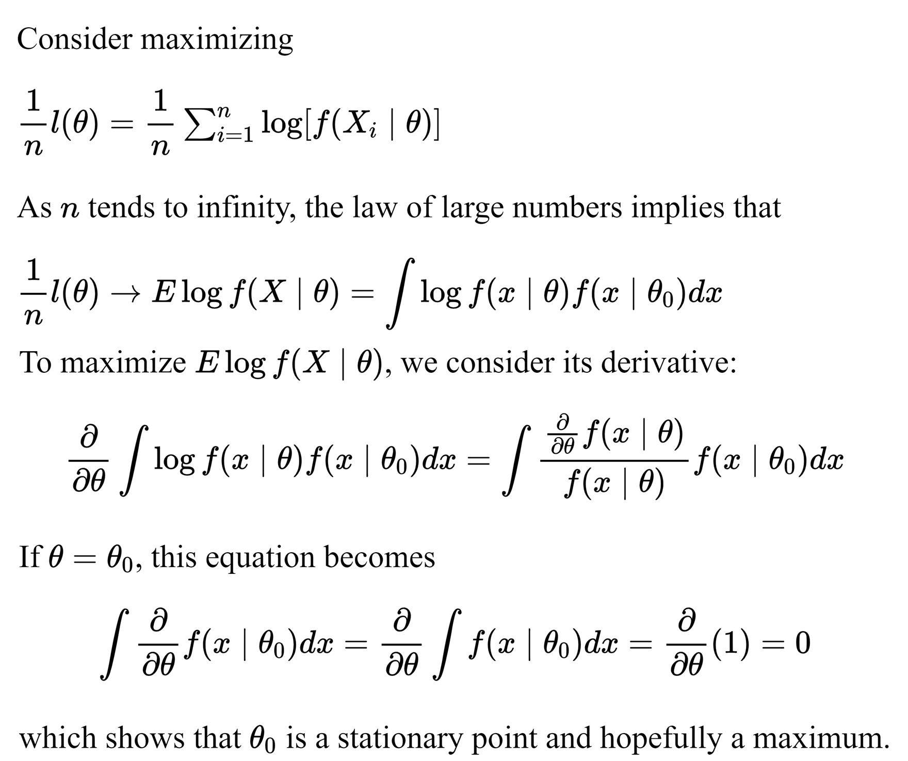
Proof of
Theorem A

Slide 7
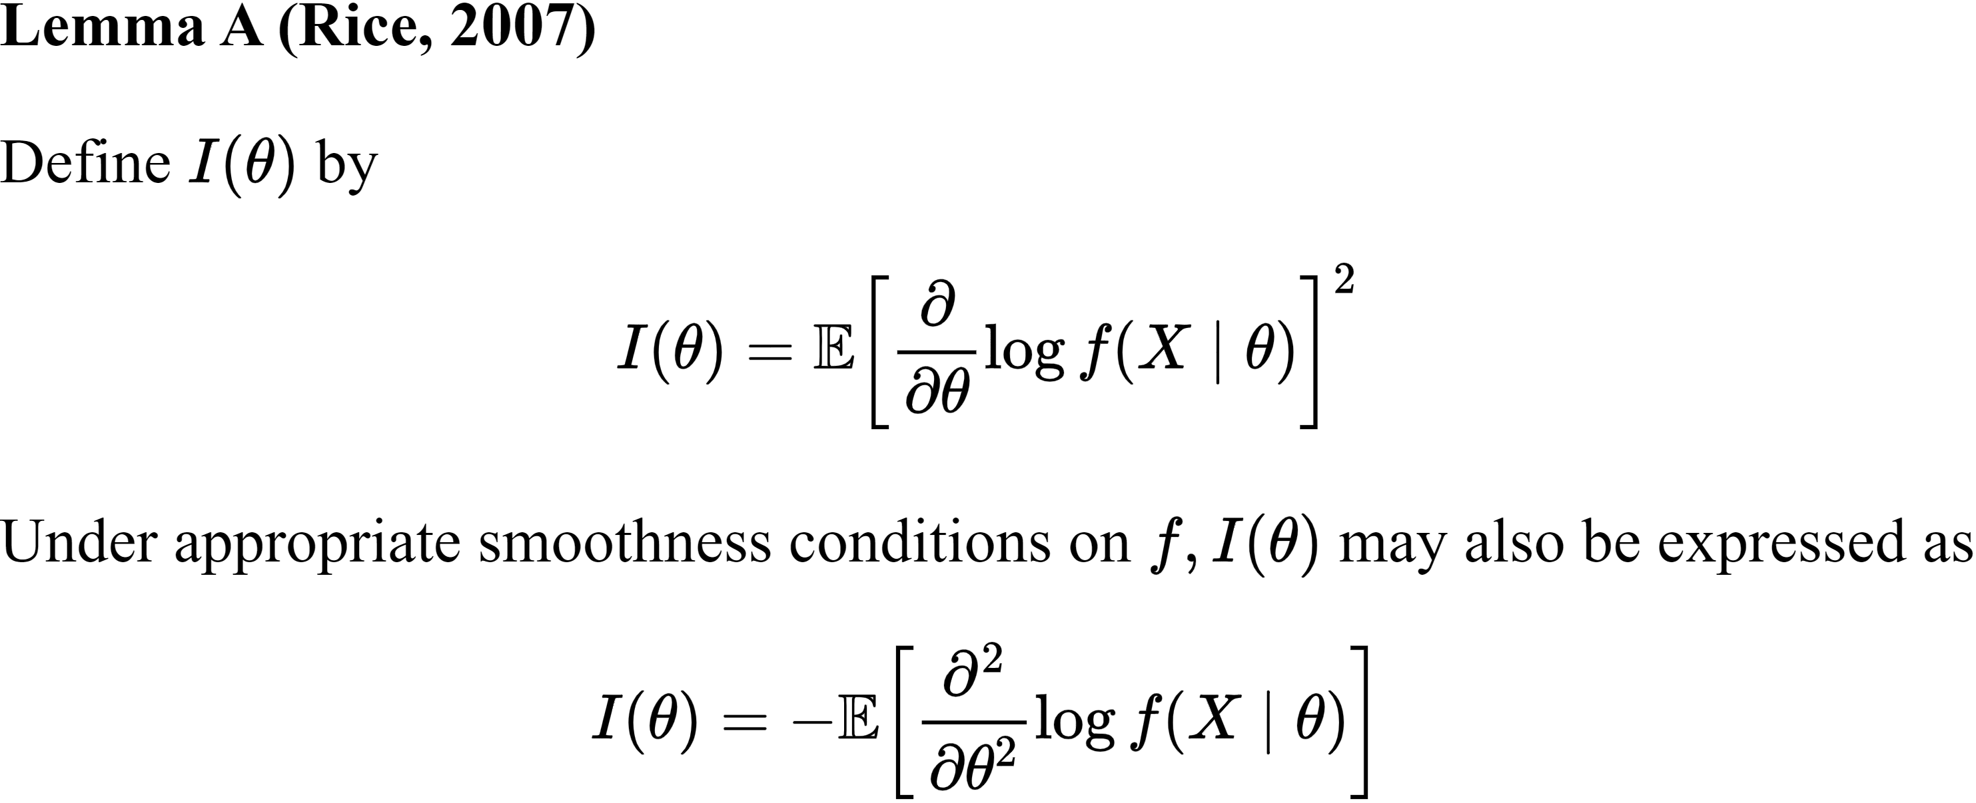
Large Sample Theory for Method of Maximum Likelihood

Slide 8
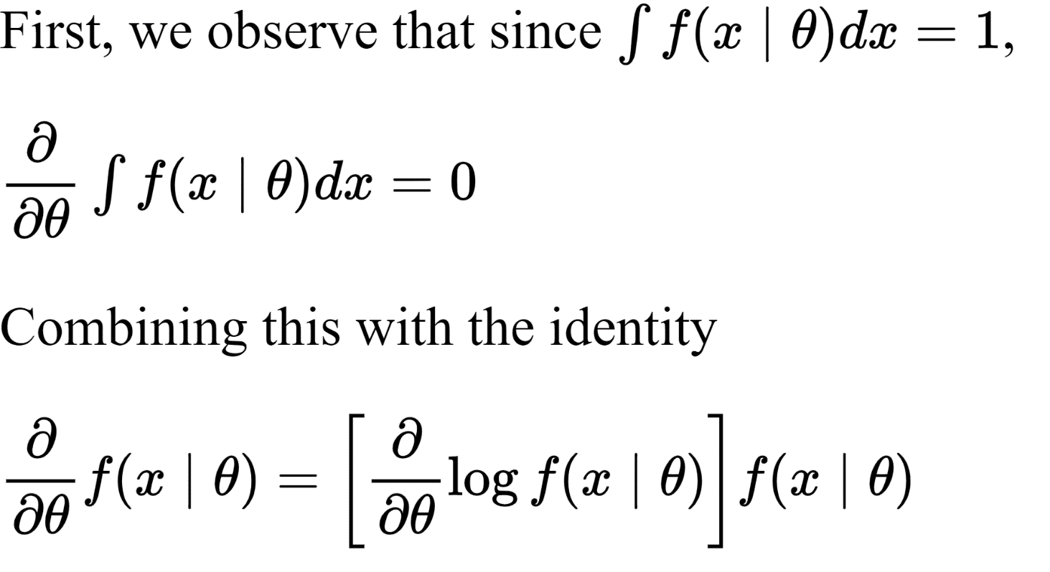

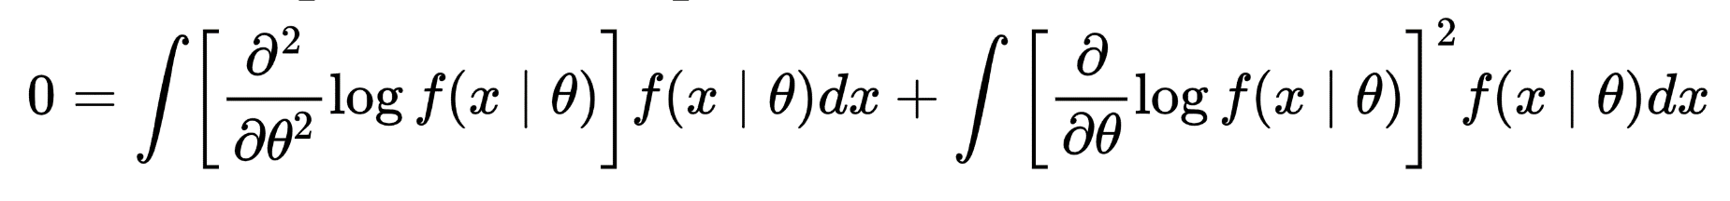
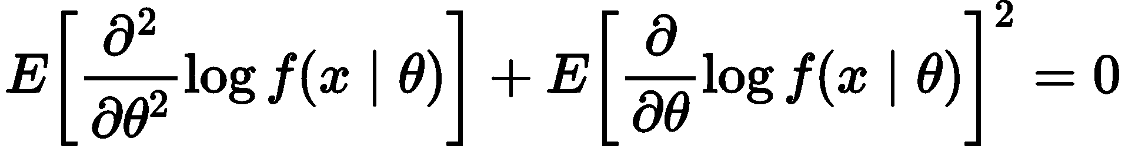
Proof of
Lemma A
Taking second derivative both sides, we obtain

Slide 9
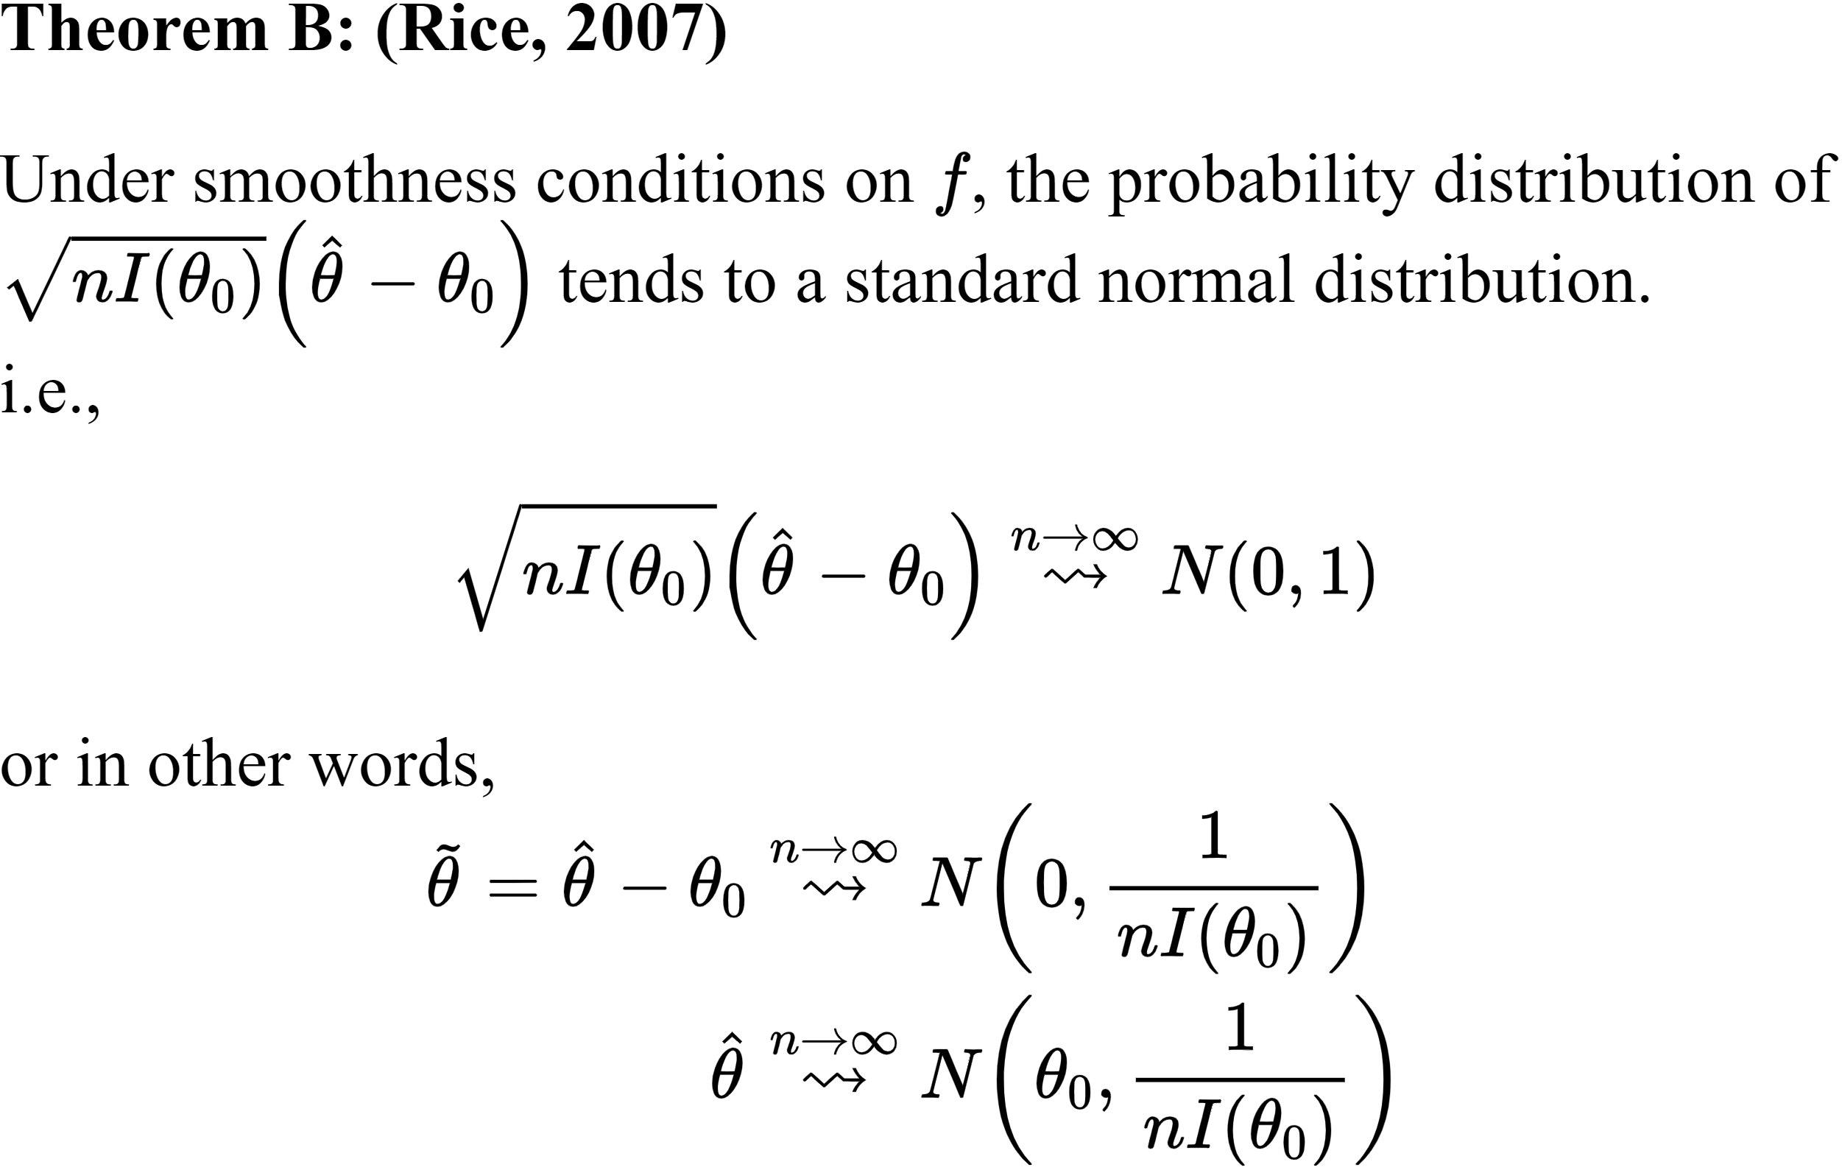
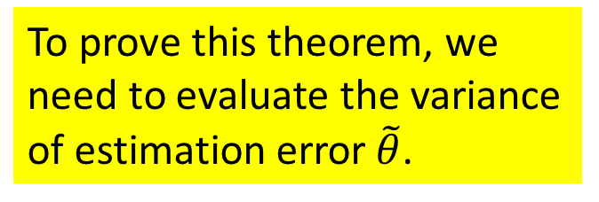
Large Sample Theory for Method of Maximum Likelihood
To prove this theorem, we need to evaluate the variance of estimation error$\tilde{θ}$.

Slide 10
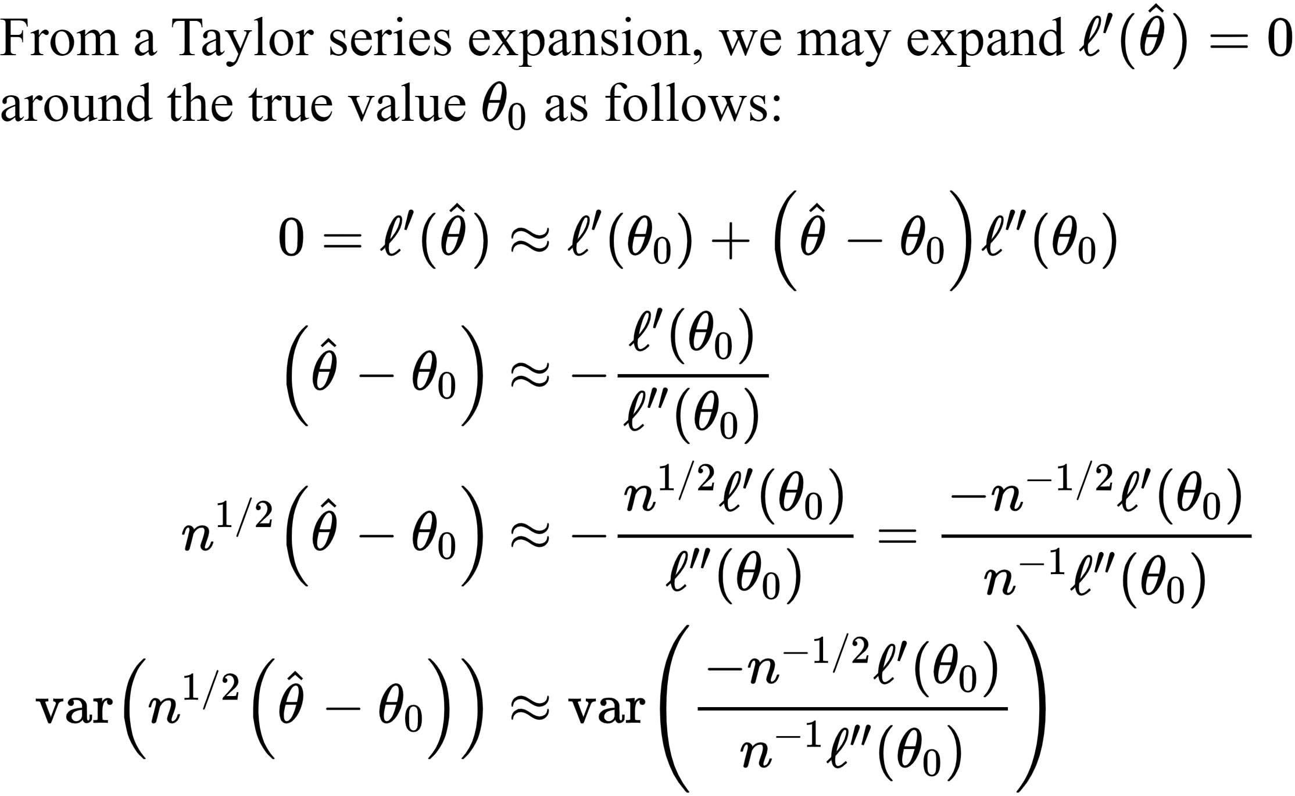
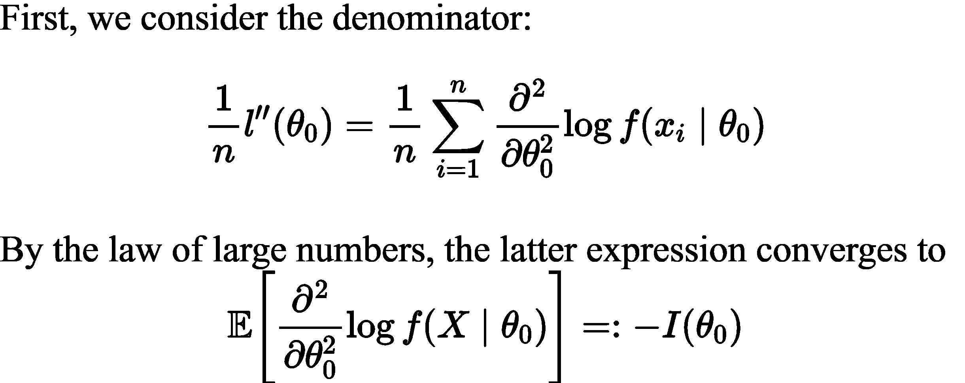
Proof of
Theorem B

Slide 11
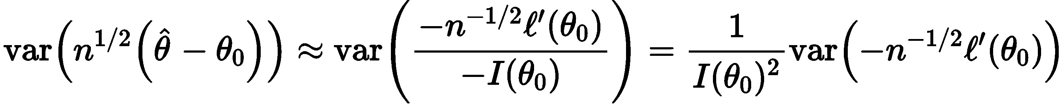
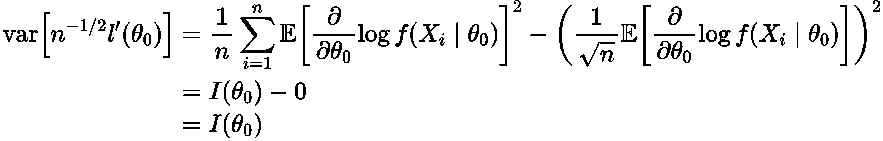
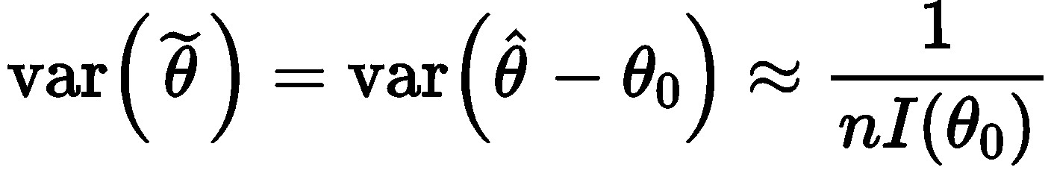
Proof of
Theorem B

